Slide 1


Slide 2
Development in Linux
CS2308
Gentry Atkinson

Slide 3
History of Unix
In the beginning, every computer manufacturer made their own OS.
Multics was an experimental time-sharing mainframe OS. It was very influential but unwieldy
Unix was developed at Bell Labs to correct issues with Multics and was introduced in 1973.
Bell could not sell Unix due to an anti-trust case, so they gave it away.

Slide 4
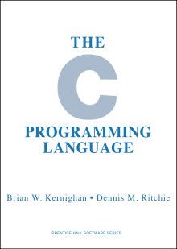
C and Unix
The C language was developed for Unix, and Unix was developed with C.
Two developers Kernighan and Ritchie, along with many others, developed Unix and C simultaneously.
Many commercial and open-source version of Unix exist.

Slide 5
Linux
In 1991 a Finnish developer named Linus Torvald created his own version of the MINIX operating system, which cam from Unix.
Many distributions of Linux exist, most are free.
Linux is highly customizable, and offers a similar graphic interface to Windows and MacOS.
Very popular with developers.

Slide 6
The Linux Shell
The human interface of an operating system is called a “shell”
  GUI: graphic user interface
  CLI: command line interface
CLIs have their own language and syntax:
  Bourne Again SHell (most common)
  C Shell (C-like syntax)
  Friendly Interactive Shell (friendly)

Slide 7
Using the CLI
The command is always the first word in an instruction to the shell.
Some commands take “arguments” (like functions do), usually the name of a file or directory.
Switches are options for changing the behavior of a command, always preceded by a dash -
Argument files can be relative to the system root or relative to the directory you are “in”

Slide 8
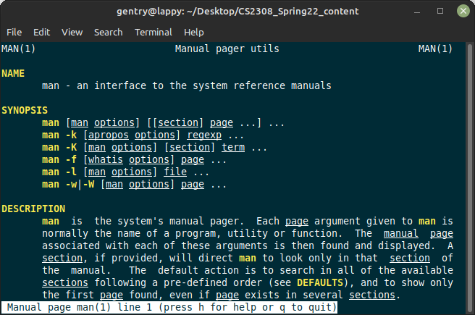
man Pages
“man” (short for manual) is a command-line tool for retrieving information about other tools.
Type man followed by another word

Slide 9
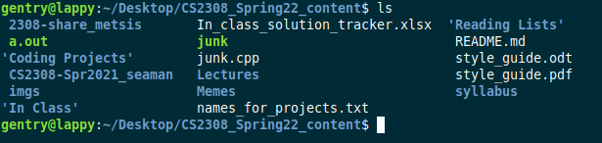
ls
The ls command is used to list the files in a directory.
Possible arguments: the name of a directory.
Possible switches:
  -a show hidden files too
  -s show the size of each file
  -f unsorted

Slide 10


pwd
Used to print the working directory. Shows the directory you are currently in.
Takes no arguments.
Can take switches, but none that are easy to explain.

Slide 11
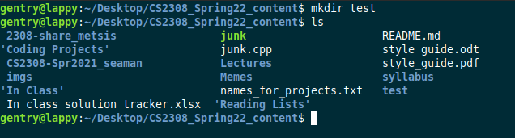
mkdir
Make a new directory.
Mandatory argument, the name of the new file.
Optional switches:
  -m set access permission (mode) of the file.

Slide 12
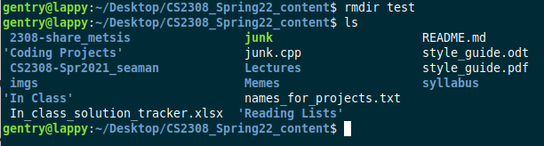
rm and rmdir
Remove (delete) a file or directory.
Mandatory argument, the name of a file or directory.
  * can be used for “everything”
Switches:
  -r recursive, delete files inside the deleted directory.
  -f force, make it happen

Slide 13
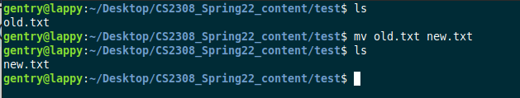
cp and mv
Copy or move a file. Similar to copy-paste and cut-paste.
Mandatory arguments: old file name and then the new file name. In that order.
Switches:
  -f force the action

Slide 14
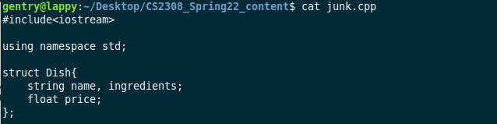
cat
Prints the contents of a file.
Mandatory argument, the name of a file.
Switches:
  -n numbers output lines

Slide 15
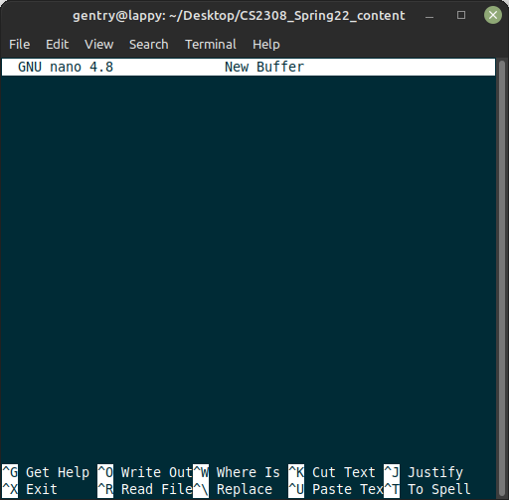
nano
Launch the nano text editor.
Optional argument, the name of file to edit.
Switches:
  -B backup old versions
  -D bold text
Other tools are listed in the editor.

Slide 16
g++
Runs the GNU C Compiler (gcc) on a C++ file.
Mandatory argument, a file to compile.
Switches:
  -o names the output (executable) file
  many, many more.
Outputs a program called a.out if the -o switch is not used.

Slide 17
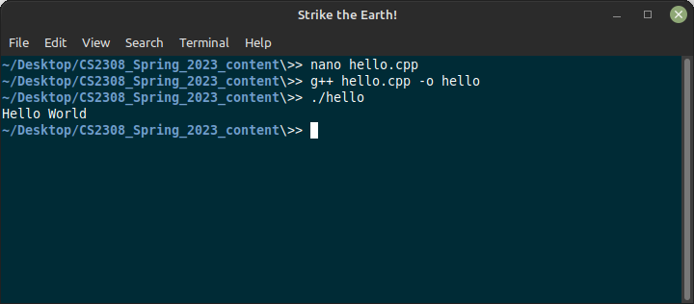
g++

Slide 18
Linux File System
The file system is a tree that branches upwards from the root: /
Each user has a home which is referenced using a ~
. is the current directory
.. is the parent of the current directory
./program runs a program in the current directory.

Slide 19
Our Linux servers
Use putty from Windows or the ssh command line tool on Mac or Linux.
Connect to:
  netID@zeus.cs.txstate.edu OR
  netID@eros.cs.txstate.edu
Type your password when prompted. You will not see the input (not even *******).
https://cs.txstate.edu/resources/labs/accounts/linux/

Slide 20
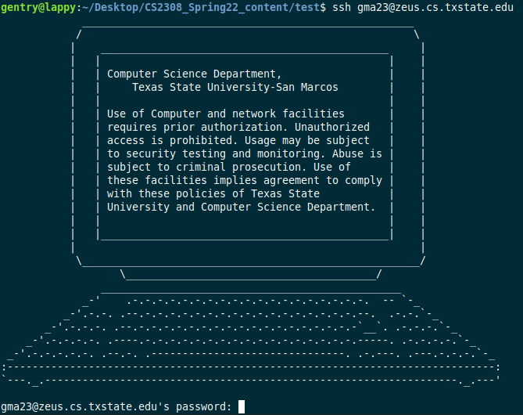
Successful Connection

Slide 21
Questions or Comments?

